Slide 1

Engineering Student Placements
Group 4
Members:
Akif Eltahir
Regina Enrile
Connor Farrell
Mohamed Metwalli
Nicole Young
Notes:
Good evening everyone, we are group 4 and our project is called Engineering Student Placements. I’ll first start off by introducing our 5 members, we have Akif, Regina, Connor, Mohamed and my name is Nicole. And we’re excited to show what we have been working on for the past couple of weeks.
Presenter: Nicole

Slide 2


Goals
Reason For Selecting This Topic
Build a Machine Learning model to predict whether a student will be selected for an internship based on several factors.
Students are in the beginning of their career and it is a challenging time for them to gain the experience needed to put them in the workforce. Understanding the data available from career services in colleges and universities will help these organizations in supporting the students to land in their dream job. Our success in developing such a model will enhance student experience and provide each one with the right guidance to start a career of their choice.
Notes:
Goals:
Our goal was to build a Machine Learning model to predict whether a student will be selected for an internship based on several factors mentioned in the following slides.
Reason For Selecting This Topic:
The reason for selecting this topic is because students are in the beginning of their career, and I’m sure some of you can relate, it’s a challenging time for them to gain the experiences needed to put them in the workforce. Understanding the data available from career services in colleges and universities will help these organizations in supporting the students to land in their dream job. It will also give the students the added incentive to do well in their remaining exams when they see what is required to be placed for an internship. Our success in developing such a model will enhance student experiences and provide each one with the right guidance to start a career of their choice.
Presenter: Nicole

Slide 3

Data Source
The data was sourced from Kaggle from an Engineering Placement dataset which features the following relevant factors:
Age
Gender
Field of Study
Past Internships
Cumulative Grade Point Average (CGPA)
Dwelling Provided
History of Backlogs
Notes:
Data Source
The dataset we used was sourced from Kaggle from an Engineering Placement dataset. The dataset was fairly clean so there wasn’t much work needed to clean it up. But we all agreed that the fields included on the dataset were all relevant factors when being placed for an internship. And it features relevant factors like:
· Age
· Gender
· Field of Study
· Past Internships
· Cumulative Grade Point Average (CGPA)
· Whether Dwelling was Provided
· AND History of Backlogs
Presenter: Nicole

Slide 4


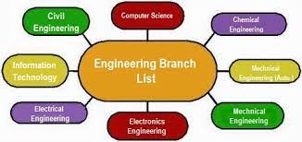

Questions
Notes:
Presenter: Akif
Questions slide:
Using the datasets, we will highlight a few questions we sought to answer through our MLM which will be discussed later. First, Are students more likely to be accepted into a placement if they have a higher GPA?, Question 2 is; Are males or females more likely to be accepted into a placement? and lastly, question 3 is, Are students more likely to receive a placement based on the stream they are in?

Slide 5
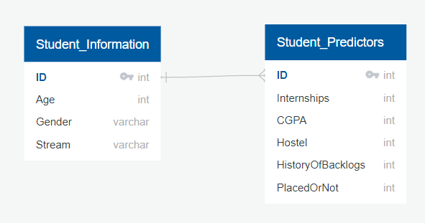

Database Integration
PostgresSQL
Join Tables: Student_Information & Student_Predictors
Database Host: AWS RDS Service
Database Server: capstone-project
Notes:
Presenter: Akif
Database slide:
To answer these questions, we created a database to host all our data. Using the data files we retrieved from Kaggle, we created tables in PostGresSQL (mention titles and point to ERD) and imported the CSV files into pgAdmin. Next, we joined (student_information and student_predictors, on ID) the tables to create a data table that will contain all the information for the database. We used AWS RDS Service to host the database on the server capstone-project. Next, we integrated our database into the MLM to preform accuracy testing and exploratory data analysis, which Mohamed will explain further.

Slide 6
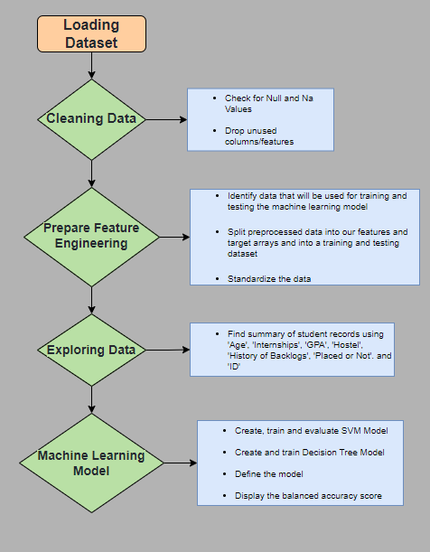
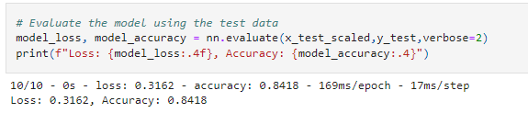

Machine Learning Model
Machine Learning Model Type: Classification model
Utilizing the features mentioned from the dataset, we are going to train a classification model - a subcategory of Supervised Machine Learning – to determine the likelihood of acceptance for future applicants. The following are the steps we will take for data preprocessing.
Notes:
Presenter: Mohammed

Slide 7

Description Of Tools Used to Create Final Dashboard
We chose to use Tableau to create the final dashboard. Tableau is a powerful interactive visualization tool that transforms data into a format that is ideal for presentation.
By using the cleaned CSV, three visualizations were created based on:
Gender
Engineering discipline
CGPA
Notes:
Presenter: Connor

Slide 8
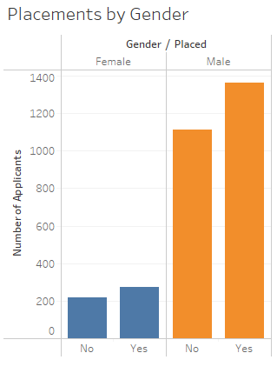
Description of Interactive Elements
1st Interactive Element
Gender
Our second graph shows the amount of applicants that were either placed or not solely by their gender
Notes:
Presenter: Connor
We can see here that males are much more likely to be placed placed instead of females. This also shows that the amount of male applicants is much higher than female applicants. This could possibly be due to there being more males in fields that are more popular for internships
Conclusion:
Since 55% of male applicants are placed and 56% of female applicants are placed, we can see that both genders are essentially equally likely to be accepted into an internship. The following factors are more indicative of the likelihood of placement.

Slide 9
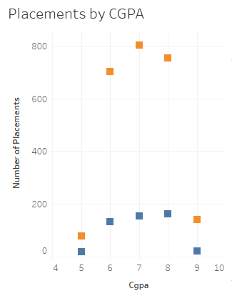

2nd Interactive Element
CGPA
Our first interactive element is a scatter plot that shows the amount of internship placements based on the applicant’s Cumulative Grade Point Average
Notes:
Presenter: Connor
From this scatter plot, we can see that the placement of males based on their CGPA is a pretty standard bell curve, where as the placement of females shows a negative skew.
Conclusion:
For students looking to get into an internship, they will be most likely to be placed if they have a CGPA of 6 or above.

Slide 10
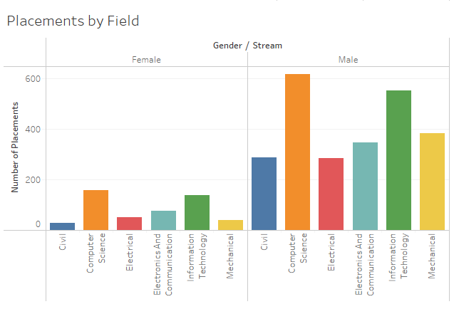
3rd Interactive Element
Discipline
The third visualization shows the number of placements by an applicant’s field of study, and then split by gender
Notes:
Presenter: Connor
From this bar graph we can see that computer science and information technology majors from both genders had the highest rate of placement. Civil and electrical engineering have approximately the same amount of placements.
Conclusion:
We can conclude that regardless of gender, it is most likely you will be placed into an internship if your engineering focus is either Computer Science or Information Technology.

Slide 11
Thank you for listening!
Q&A
Notes:
Summary:
This is the end of our presentation.
We also wanted to include a recommendation for future analysis and that is to use a dataset with more fields and a more inclusive gender field as they only provided the male and female genders. And something the team would’ve done differently - Be more involved in other roles?
Thank you everyone for listening, and we will open it up for Q&A.
Presenter: Connor

